Slide 1
Project 4 – Heart disease prediction
Nick Carr

Slide 2
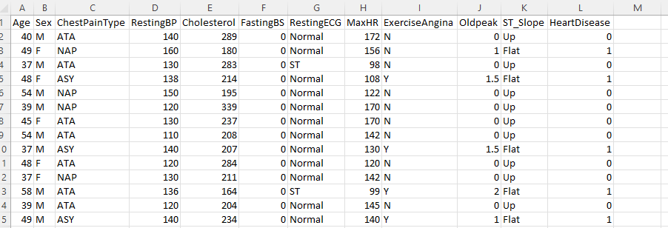
Data
Heart Failure Prediction Dataset
It was sourced from 4 different hospitals worldwide. (Hungarian Institute of Cardiology, University Hospital Zurich, University Hospital Basel and V.A. Medical Centre, California.
Age, sex, chest pain type, resting blood pressure, Cholesterol, fasting blood sugar, resting electrocardiogram result, maximum heart rate, exercise angina, old peak and ST slope.
Over 900 data sets were provided.

Slide 3
Mon | Tues | Wed | Thurs | Fri | Sat | Sun
Week 1 | Create rough timeline and rough steps to be taken | Look for an interesting data set to be used | Explore data set and make any changes to the data | Start applying machine learning to the dataset to find the best accuracy. | Create basic html/css and flask skeleton | Create a database connection to save any input data.
Week 2 | Get the backend of the web app sorted | Start to make the web page presentable | Finish web page/ start documentation. | Present

Slide 4
Data
Age: age of the patient [years]
Sex: sex of the patient [M: Male, F: Female]
ChestPainType: chest pain type [TA: Typical Angina, ATA: Atypical Angina, NAP: Non-Anginal Pain, ASY: Asymptomatic]
RestingBP: resting blood pressure [mm Hg]
Cholesterol: serum cholesterol [mm/dl]
FastingBS: fasting blood sugar [1: if FastingBS > 120 mg/dl, 0: otherwise]
RestingECG: resting electrocardiogram results [Normal: Normal, ST: having ST-T wave abnormality (T wave inversions and/or ST elevation or depression of > 0.05 mV), LVH: showing probable or definite left ventricular hypertrophy by Estes' criteria]
MaxHR: maximum heart rate achieved [Numeric value between 60 and 202]
ExerciseAngina: exercise-induced angina [Y: Yes, N: No]
Oldpeak: oldpeak = ST [Numeric value measured in depression]
ST_Slope: the slope of the peak exercise ST segment [Up: upsloping, Flat: flat, Down: downsloping]

Slide 5
Why this topic?
Cardiovascular disease is the worlds leading cause of death.
I am very curious as how data is used in the health care industry.

Slide 6
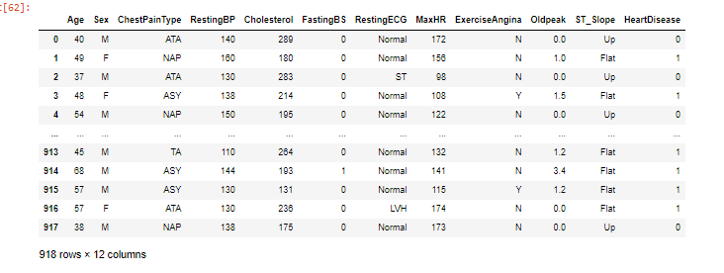
Data exploration/cleaning
Imported data was a combination of numerical and categorical data. I did the normal routine of checking the info(), describe(), insull() functions to learn more.
Changed categorical data to numerical

Slide 7
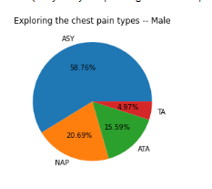
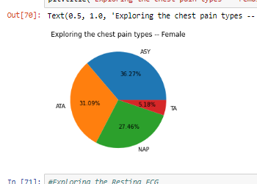
Data exploration
I performed some exploration, such as separating male and female, then looking at some columns in a pie chart.

Slide 8
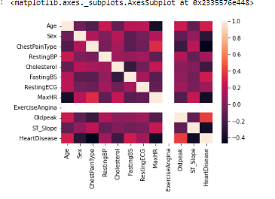
Data exploration
Heat map to see how linear the data set is
Also performed a pairplot in seaborn to visualise the

Slide 9
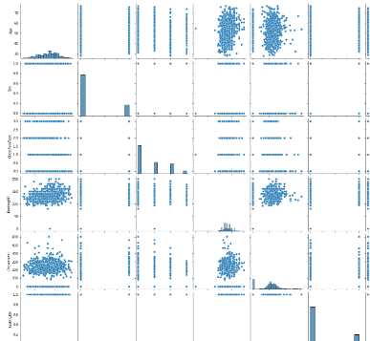
Data exploration
Seaborn pairplot to see any linear relations

Slide 10
Machine learning models
Linear
Logistic
KNN
SVM
Decision Tree
Neural Network

Slide 11
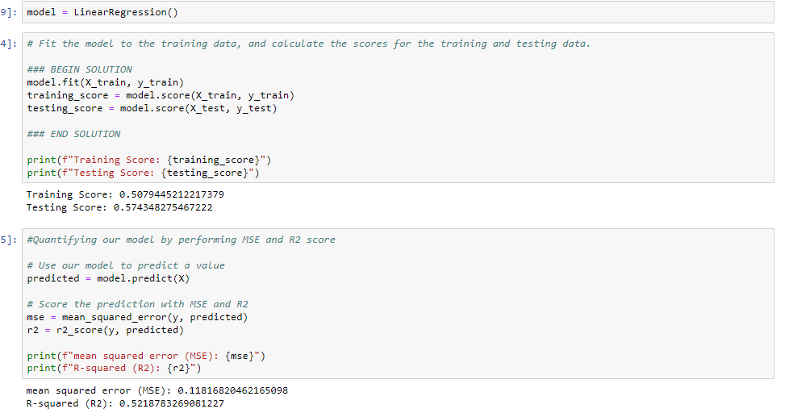
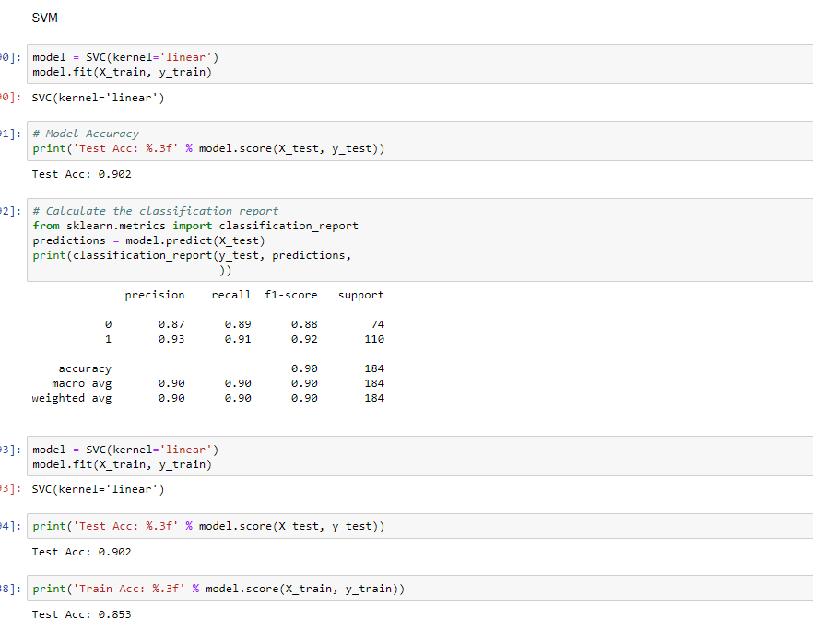
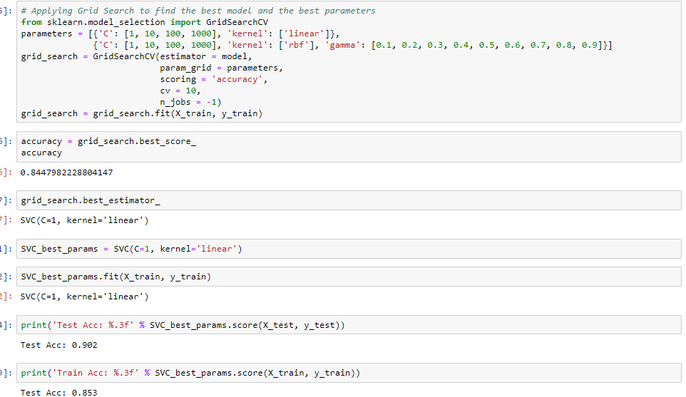
Machine learning models

Slide 12
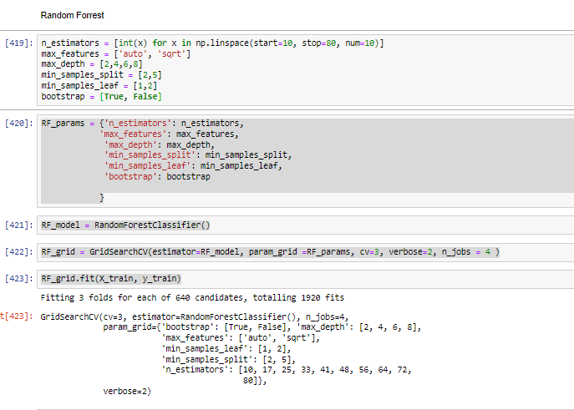
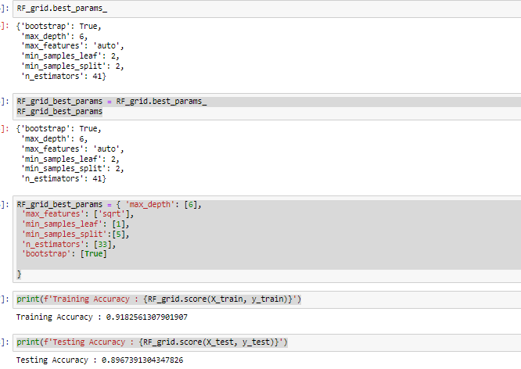
Machine learning

Slide 13
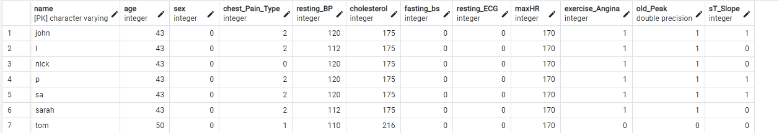
Postgres
Input data gets saved to a data base. This can then be added to the machine learning model, in which it can be trained to be more accurate for future predictions.

Slide 14
Challenges
Python challenges in terms of using get_dummies, then using those columns in html.
Using plotly in flask
HTML and CSS are not my strong point.
Getting a deep understanding of the hyperparameters for the machine learning models
First project on my own, unsure how to approach this.
Require deeper knowledge of hyperparameters.
Putting everything together

Slide 15
Thank you

